Slide 1

Agile Methodologies
David E. Bernholdt Oak Ridge National Laboratory
Michael A. Heroux, James M. Willenbring Sandia National Laboratories Better Scientific Software Tutorial RF SciDAC 2020 Workshop
See slide 2 for license details

Slide 2
License, Citation and Acknowledgements
License and Citation
This work is licensed under a Creative Commons Attribution 4.0 International License (CC BY 4.0).
The requested citation the overall tutorial is: David E. Bernholdt, Better Scientific Software tutorial, in RF SciDAC 2020 Workshop, Knoxville, Tennessee. DOI: 10.6084/m9.figshare.11918397
Individual modules may be cited as Speaker, Module Title, in Better Scientific Software Tutorial…
Acknowledgements
Additional contributors to this this tutorial include: Anshu Dubey, Mike Heroux, Alicia Klinvex, Jared O’Neal, and Katherine Riley, James M. Willenbring
This work was supported by the U.S. Department of Energy Office of Science, Office of Advanced Scientific Computing Research (ASCR), and by the Exascale Computing Project (17-SC-20-SC), a collaborative effort of the U.S. Department of Energy Office of Science and the National Nuclear Security Administration.
This work was performed in part at the Argonne National Laboratory, which is managed managed by UChicago Argonne, LLC for the U.S. Department of Energy under Contract No. DE-AC02-06CH11357.
This work was performed in part at the Oak Ridge National Laboratory, which is managed by UT-Battelle, LLC for the U.S. Department of Energy under Contract No. DE-AC05-00OR22725.
This work was performed in part at Sandia National Laboratories. Sandia National Laboratories is a multi-mission laboratory managed and operated by National Technology and Engineering Solutions of Sandia, LLC., a wholly owned subsidiary of Honeywell International, Inc., for the U.S. Department of Energy’s National Nuclear Security Administration under contract DE-NA0003525. SAND NO SAND2017-5474 PE

Slide 3
Outline
Small Team Models, Challenges
Agile workflow management for small teams.
Intro to terminology and approaches
Overview of Kanban
Building on Kanban
Free tools: Trello, GitHub
PSIP: Productivity and Sustainability Improvement Planning

Slide 4
Small Teams
Ideas for managing transitions and steady work.

Slide 5
Small team interaction model
Team composition:
Senior staff, faculty:
Stable presence, in charge of science questions, experiments.
Know the conceptual models well.
Spend less time writing code, fuzzy on details.
Junior staff, students:
Transient, dual focus (science results, next position).
Staged experience: New, experienced, departing.
Learning conceptual models.
Write most code, know details.
Large teams have additional interaction challenges, and are often composed of smaller sub-teams.

Slide 6
Small team challenges
Heavy processes are often neither necessary nor appropriate
Adopt only those processes that add value
Ramping up new junior members:
Background.
Conceptual models.
Software practices, processes, tools.
Preparing for departure of experienced juniors.
Doing today those things needed for retaining work value.
Managing dual focus.

Slide 7
Research Team Member Lifecycle
Initiation Setup
Identify project activities
Create initiation checklist
Ramp Up
Work initiation checklist
Initiate project activities
Ongoing Planning
Kanban workflow
Observe policies
Start
Team Member Lifecycle
Quick ramp up
Disciplined activities
Sustained contributions
Repeat
Start process again
Ongoing Work
Conduct activities
Observe policies
Depart
Work complete
Work transferred
Contribution sustained
Ramp Down
Work exit checklist
Leave project activities
Exit Setup
Identify final deliverables
Create exit checklist

Slide 8
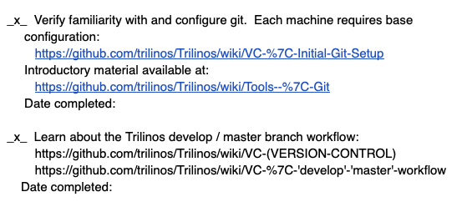
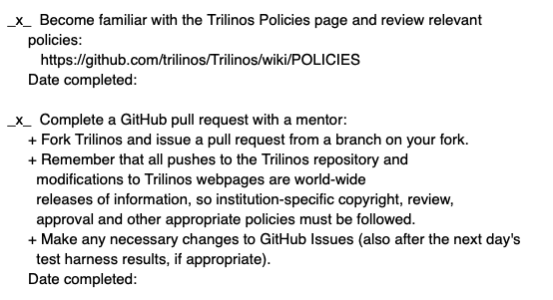
Checklists & Policies
Team Member Phase
New Team Member | Steady Contributor | Departing Member
Checklist | Policies | Checklist
New developer checklist snippet
New, departing team member checklists:
Example: Trilinos New Developer Checklist.
Simple – prevents omissions
https://github.com/trilinos/Trilinos/wiki/New-Trilinos-Developers
Steady state: Policy-driven.
Example: xSDK Community policies.
https://xsdk.info/policies/

Slide 9
Agile Methodologies

Slide 10
Why Agile?
Fits the research experience better than heavier-weight approaches
Aligns more naturally with how scientific progress is made
Well-suited for scientific software efforts (when tailored correctly)
Works well for small teams
Provides meaningful, beneficial structure that promotes
Productivity
Productization
Sustainability
Flexibility in requirements
Communication

Slide 11
What is Agile?
Agile is not a software development lifecycle model
I’ve seen Agile informally defined as
I don’t write documentation
I don’t do formal requirements, design, or really test…
Agile is not an excuse to do sloppy work
Some people consider agile to be synonymous with Scrum
From Atlassian: Scrum is a framework that helps teams work together
Scrum is Agile, Agile is not (only) Scrum
A square is a rectangle, not all rectangles are squares
Agile is not Kanban either

Slide 12
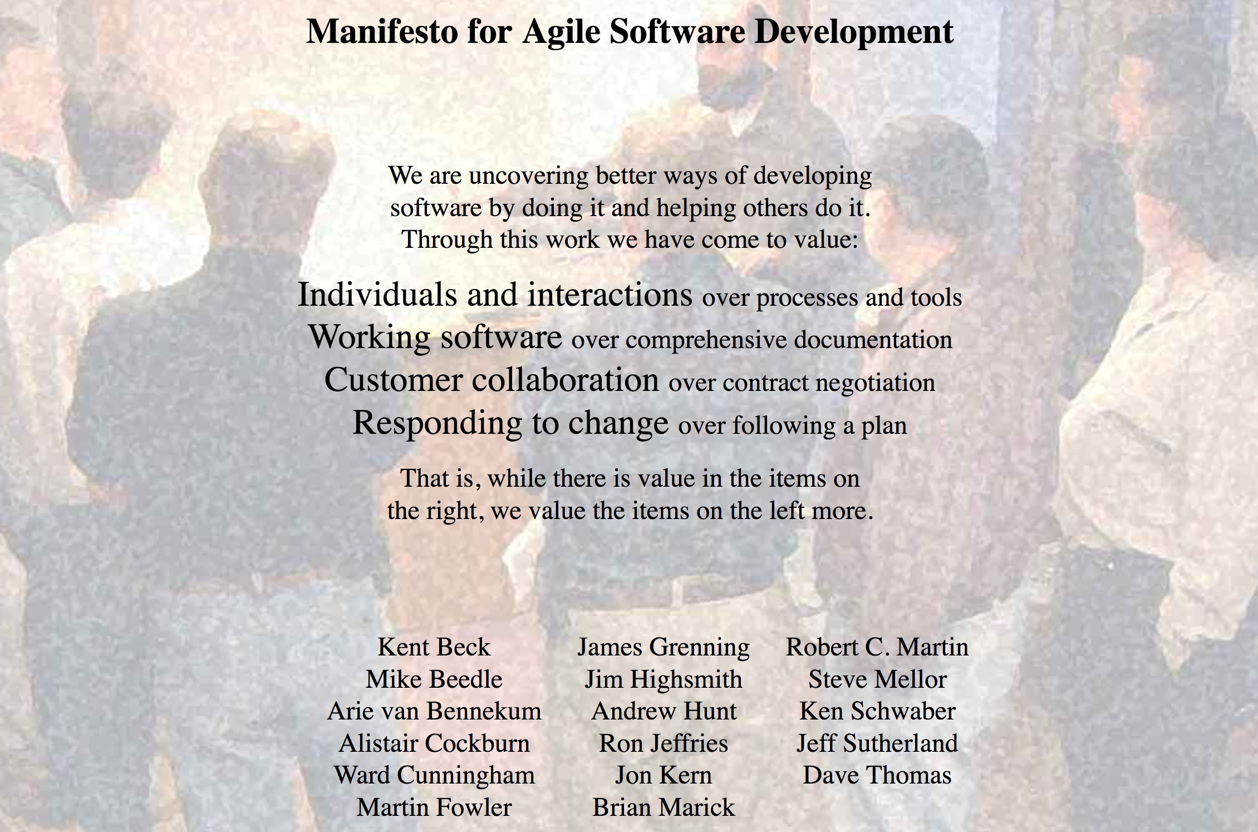
What is Agile?
http://agilemanifesto.org/

Slide 13
Principles behind the Agile Manifesto
Our highest priority is to satisfy the customer through early and continuous delivery of valuable software.
Welcome changing requirements, even late in development. Agile processes harness change for the customer's competitive advantage.
Deliver working software frequently, from a couple of weeks to a couple of months, with a preference to the shorter timescale.
Business people and developers must work together daily throughout the project.
Build projects around motivated individuals. Give them the environment and support they need, and trust them to get the job done.
The most efficient and effective method of conveying information to and within a development team is face-to-face conversation.

Slide 14
Principles behind the Agile Manifesto
Working software is the primary measure of progress.
Agile processes promote sustainable development. The sponsors, developers, and users should be able to maintain a constant pace indefinitely.
Continuous attention to technical excellence and good design enhances agility.
Simplicity--the art of maximizing the amount of work not done- is essential.
The best architectures, requirements, and designs emerge from self-organizing teams.
At regular intervals, the team reflects on how to become more effective, then tunes and adjusts its behavior accordingly.

Slide 15
Getting Started with Agile
Agile principles are not hard and fast rules
Try adopting a few Agile practices
Following a rigid, ill-fit framework usually leads to failure
Kanban is a good starting framework
Follow basic principles, add practices when advantageous
Better than removing elements from Scrum
Task: Have Eureka moment by Tuesday.
Scrum

Slide 16
Kanban principles
Limit number of “In Progress” tasks
Must be tuned by each team
Common convention: 2n-1 tasks where n = # team members
Productivity improvement:
Optimize “flexibility vs swap overhead” balance. No overcommitting.
Productivity weakness exposed as bottleneck. Team must identify and fix the bottleneck.
Effective in R&D setting. Avoids a deadline-based approach. Deadlines are dealt with in a different way.
Provides a board for viewing and managing issues

Slide 17
Basic Kanban
Backlog | Ready | In Progress | Done
Any task idea Trim occasionally Source for other columns | Task + description of how to do it. Could be pulled when slot opens. Typically comes from backlog. | Task you are working on right now. The only Kanban rule: Can have only so many “In Progress” tasks. Limit is based on experience, calibration. Key: Work is pulled. You are in charge! | Completed tasks. Record of your life activities. Rate of completion is your “velocity”.
Notes:
Ready column is not strictly required, sometimes called “Selected for development”.
Other common column: In Review
Can be creative with columns:
Waiting on Advisor Confirmation.
Blocked

Slide 18

Personal Kanban
Personal Kanban: Kanban applied to one person.
Apply Kanban principles to your life.
Fully adaptable.
Personal Kanban: Commercial book/website.
Useful, but not necessary.
https://bssw.io/items/using-personal-kanban-for-productivity
http://www.personalkanban.com

Slide 19
Kanban tools
Wall, whiteboard, blackboard: Basic approach.
Software, cloud-based:
Trello, JIRA, GitHub Issues & Project Board.
Many more.
I use Trello (browser, Android, iPhone, iPad).
Can add, view, update, anytime, anywhere.
Different boards for different contexts
Effective when people are split on multiple projects

Slide 20
Big question: How many tasks?
No single answer. Choose something and adjust from there.
Personal Kanban approach: Start with 2 or 3.
Teams: Consider 2n-1, where n=number of team members.
Use a freeway traffic analogy:
Does traffic flow best when fully packed? No.
Same thing with your effectiveness.
Spend time consulting board regularly.
Brings focus.
Enables reflection, retrospection.
Use slack time effectively.
When you get out of the habit, start up again.
Steers towards previously started tasks

Slide 21
Importance of “In Progress” concept for you
Junior community members:
Less control over tasks.
Given by supervisor.
In Progress column: Protects you.
If asked to take on another task, respond:
Is this important enough to
back-burner a, b, and c?
become less efficient?
Sometimes it is.

Slide 22
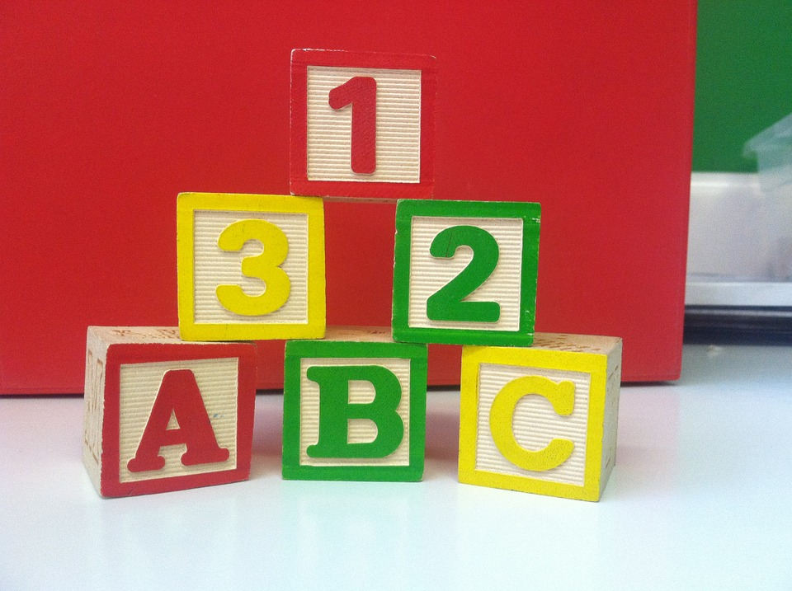
Building on Kanban
Focus: Solve issues!
(not add process)
15 minute stand-ups
Maybe not daily
Planning meetings
Retrospectives
Scrum Master
Product Owner
Epic, story, task
Definition of Done

Slide 23
Building on Kanban
Epic, Story, Task
Formal or informal
Start with high-level requirements
Break down and refine when and as needed
Close to when the work will be done
Only for work that will take place
Can be valuable for estimating
Epics are very high level objectives
Stories should represent an increment of value to the customer
”Done” criteria – understandable to user
Tasks are the steps necessary to complete a story
May not individually provide value to the customer

Slide 24
Building on Kanban
User stories (optional)
Form: As a <stakeholder>, I want <describe what is needed> so that <why do you want this?>
Can be useful to improve communication and requirements elicitation
In heat example:
Epic: Refactor code for enhanced modularity
Story 1: Separate out utilities
Example associated user story: As a developer, I want to modularize the heat equation utilities so that I can more easily make use of the utilities for other projects.
Story 2: Separate out integration function
Task 1: Add sufficient testing for integration function to protect functionality during refactor
Task 2: Generalize interface to allow alternative implementations
Task 3: Expose current integration function through the new interface & run tests

Slide 25
Building on Kanban
Key concept:
It is easier to accurately estimate many small tasks than to estimate a large epic.
Epic: Huge refactor effort
Tasks:
Add unit tests
Generalize interface
Expose existing interface
Agile estimation
Estimating is hard
Requires practice
With practice, it is still hard
Stories are estimated using “story points”
Relative estimate
Many estimating techniques
Should NOT map to hours, days, etc
Tasks are estimated in hours
Absolute estimate
Useful for planning schedules

Slide 26
Samples from Collegeville Org: Kanban Board

Slide 27
Kanban in GitHub
GitHub supports basic Agile development workflows
Filing issues
@mention
Kanban board
Projects
GitHub lacks more advanced features
Dependencies between issues
You can reference one issue in another
Advanced notification schemes
Custom fields
You can create custom labels

Slide 28

Building on Kanban
A-Team Tools: A collection of resources for understanding and applying lightweight agile practices to your scientific SW project
Especially useful for
Small teams
Teams of teams
Teams that frequently have members come and go
https://betterscientificsoftware.github.io/A-Team-Tools/

Slide 29
How To Get Better
“Use iteration and incrementation only for projects you want to succeed.”
Adaptation of Martin Fowler quote

Slide 30
Strategy for Incremental Productivity Improvements
Identify, analyze, prototype, test, revise, deploy. Repeat.
Realistic: There is a cost.
Startup: Overhead
Payoff: Best if soon, clear
Working model:
Reserve acceptable time/effort for improvement.
Improve how you do your work on the way to getting it done.
Repeat.
Old Process
New Process
Cost
Start
Progress
Finish

Slide 31
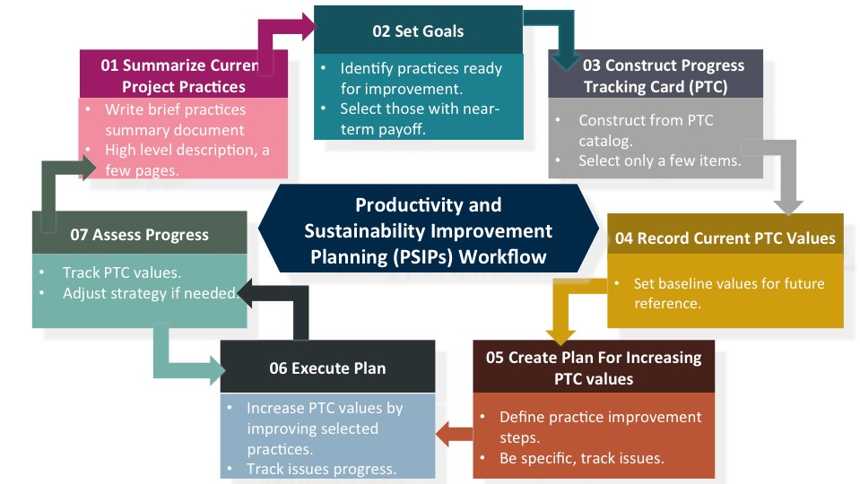
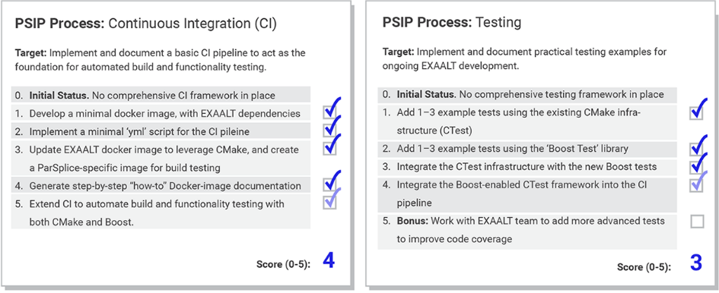
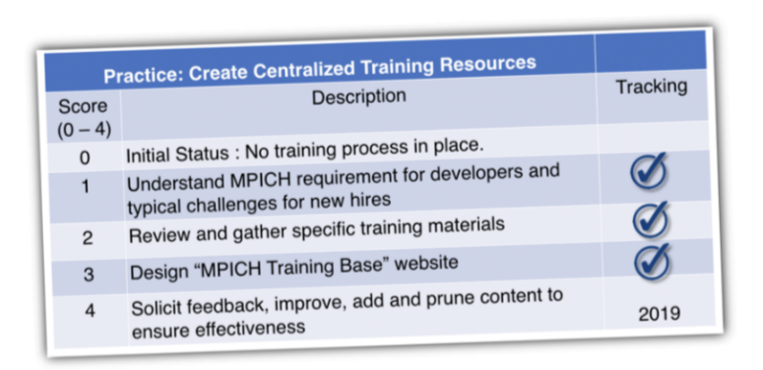
Productivity and Sustainability Improvement Planning (PSIP) Examples: EXAALT & MPICH – Add PSIP URL
PSIP workflow helps a team create user stories, identify areas for improvement, select a specific area and topic for a single improvement cycle, and then develop those improvements with specific metrics for success.
EXAALT PSIP: Continuous integration (CI) testing
BSSw blog article: Adopting Continuous Integration for Long Timescale Materials Simulation, Rick Zamora (Sept 2018)
MPICH PSIP: Onboarding new team members

Slide 32
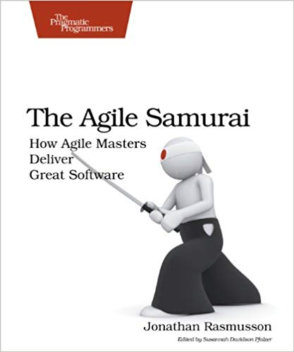
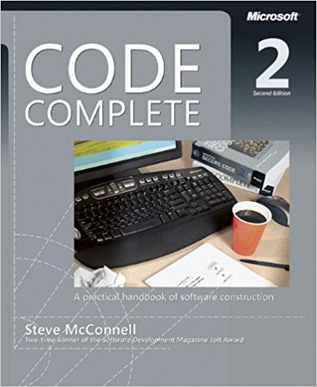
Other Resources
The Agile Samurai: How Agile Masters Deliver Great Software (Pragmatic Programmers), Jonathan Rasmusson.
http://a.co/eUGIe95
Excellent, readable book on Agile methodologies.
Also available on Audible.
Code Complete: A Practical Handbook of Software Construction, Steve McConnell.
http://a.co/eEgWvKj
Great text on software.
Construx website has large collection of content.
More Effective Agile: A Roadmap for Software Leaders, Steve McConnell.
http://a.co/22EPvt6
New: A realistic view of Agile effectiveness with great advice for project leaders.

Slide 33
Agenda
Time | Module | Topic | Speaker
1:00pm-1:05pm | 00 | Introduction | David E. Bernholdt, ORNL
1:05pm-1:30pm | 01 | Overview of Best Practices in HPC Software Development | David E. Bernholdt, ORNL
1:30pm-2:00pm | 02 | Agile Methodologies and Useful GitHub Tools | David E. Bernholdt, ORNL
2:00pm-2:30pm | 03 | Improving Reproducibility through Better Software Practices | David E. Bernholdt, ORNL
2:30pm-2:45pm |  | Q&A | All
2:45pm-3:30pm |  | Break
3:30pm-4:15pm | 04 | Software Design and Testing | David E. Bernholdt, ORNL
4:14pm-4:45pm | 05 | Continuous Integration | David E. Bernholdt, ORNL
4:45pm-5:00pm |  | Q&A | All

Slide 34
A Bit about Scrum: Roles
Scrum team
Product Owner
Interface between development team and stakeholders. Responsible for defining and managing work backlog. Needs good domain knowledge. Needs adequate time to do job well.
Scrum Master
Leads and coaches development team. Assures scrum processes followed. Needs good Scrum knowledge and discipline. Can be a developer if sufficient time.
Development Team
Cross-functional group of 3 – 9 that develops product. Completes all work necessary to be done-done. Collectively need design, development, testing, documentation skills. Works in collaboration with product owner, scrum master.

Slide 35
A Bit about Scrum: Process
15-min standup
What did you do yesterday?
What will you do today?
What is blocking progress?
Daily scrum
Product Backlog
Prioritized requirements, features of the product
Sprint Backlog
Enough work for sprint; integral capabilities
Increment
Product with new working features.
*Sprint Planning
Sprint: 1 – 3 weeks
Sprint Review
Retrospective
Repeat
* Sprint planning happens during previous sprint

Slide 36
Team Management Example
Team Policy
Checklists
Kanban Board

Slide 37
Step 1: Create Issues-only GitHub repo
Go to https://github.com/username
Example: https://github.com/maherou
Create new repo:
Click on “+” (upper right).
Select New repository…
Give repo a name, e.g., Issues
Select Public. In real life, this repo is often private (requires $ or special status)
Init with README.
Don’t add .gitignore or license.
Click Create Repository.

Slide 38
Step 2: Define Team Policy
Create file:
Go to new repo: Issues.
Select <> Code tab.
Select Create new file TeamPolicy.md
Questions to address:
How members support team?
How team supports members?
Community version:
http://contributor-covenant.org
Policy is living document:
Informal good practices added.
Avoidable bad situations addressed.

Slide 39
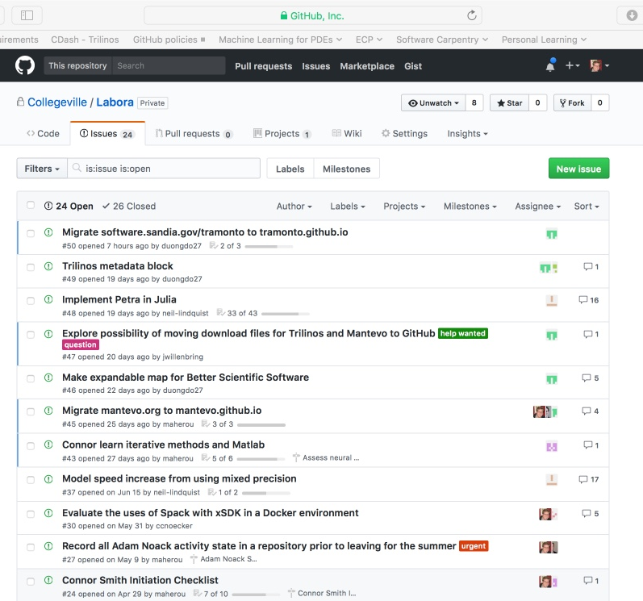
Step 3a: Create Issues
Select the Issues tab.
Click on New Issue.
Type in task statement 1 (from list).
Type in title only.
Click Submit new issue
Repeat.

Slide 40
Step 3b: Create Initiation Checklist
Select the Issues tab.
Click on New Issue.
Select a classmate.
Type in title: Pat Evans Initiation Checklist
Add checklist items:
Use syntax: - [ ] Description
Spaces required

Slide 41
Step 4: Create Kanban Board
Select Projects tab
Click New Project
Use title
Team Kanban board
Add these columns:
Backlog, Ready, In progress, In review, Done.
Click on +Add cards (upper right).
Move each issue to the proper Kanban column

Slide 42
Next Steps: Real Life
Create a GitHub Org and set of repos for your team:
Each team member has an individual repo.
Each project has a repo.
One special repo for issues.
Track all work:
Use checklists for initiation, exit, any big new effort.
Create Kanban board. Keep it current.
Aggregate related issues using milestones.
Drive meetings using Kanban board.
Adapt this approach to meet your needs.
When you start to get sloppy, get back on track.

